Slide 1
Al-Huda Foundation
10th Global Islamic Microfinance Forum
Dubai
December 12, 2021
Funding Sources to Flourish Islamic Microfinance Industry
" Rural Empowerment with Focus on Female Gender"
By Zaigham M. Rizvi
zaigham2r@yahoo.com

Slide 2
Microfinance Penetration in Pakistan
The number of active borrowers crossing the 8 million mark for the first time,
Microcredit outreach in the country grew 5.8 per cent on a quarterly basis in April-June, 2021.
The gross loan portfolio of the entire sector amounted to Rs355.7 billion at the end of the Q2, 2021
Up 4.5pc from the preceding three-month period.
State Bank of Pakistan (SBP) launched debt relief scheme for MF Borrowers under COVID Relief.
Active Borrowers:
Mobilink Microfinance Bank (1.7m),
Khushhali Bank (859,223)
Akhuwat Islamic Microfinance (767,111).
Loan Portfolio:
Khushhali Bank (Rs66bn. )
First Microfinance Bank (Rs48.7bn)
U Microfinance Bank (Rs34.7bn).
The fastest-growing microfinance provider in terms of number of borrowers:
Taleem Finance Company,
Sindh Rural Support Organization
Mobilink Microfinance Bank.

Slide 3
Rural Pakistan, more so Women need Economic Empowerment
First Step of this Thousand Miles Journey: Microfinance Inclusion
While Micro-Finance Institutions (MFIs) in Pakistan are expanding in their target market, their penetration in Rural Pakistan needs much more to be done.
National Rural Support Program is lead institution having a focus towards this objective.
Not much data is available on effective financial inclusion of rural habitat, and inclusion of females
More than half of Pakistan’s total population (220 mn) is Rural, i.e., half of rural Pakistan is female.
One of four women in Pakistan are part of rural habitat. They need to play a proactive economic role.
Challenges for MFIs:
Ensuring financial inclusion of rural habitat, more so females
Banks like agriculture finance bank (ZTBL), and MFIs to design effective and viable business models
Need for Research on Agro-Based Products and production in villages, where rural female gender could be engaged for value-addition
Ensure MFI Loans are effectively used for value-addition businesses, not go for consumption
Inclusion of Women Persons with Disabilities for empowerment under MFI Finance.
Energy/Electricity empowerment to un-served rural habitat
Pro-active collaboration between Agriculture Finance institutions like ZTBL, NBP, NRSP etc.,
agri-research institutions like Pakistan Agricultural Research Council (PARC) and Academia
Best practice business odel on this is Bangladesh, more so Grameen Business Model

Slide 4
Grameen Bank (GB) Bangladesh
Grameen Bank, under the leadership of its Founder Dr. M. Yunus began its operations in Rural Bangladesh/Villages through innovative pilot projects in 1976.
With a focus on empowerment of Women. Dr. Yunus started with village based production units
Grameen Bank (GB) formally began its operations in 1983 as a Specialized Credit Intuition.
Grameen gives small business loans to the poorest of the rural poor, on a group liability basis.
The Bank provides investment advice to its potential clients on how to develop and run business
The success of Grameen Bank as a bank for the poor is its creation of a market niche as well as outreach to women among the poor.
The main product in the beginning was developing Rural Garment Industry, where a group of women in a village would produce garments as needed by the market.
Such small rural garment units were then linked with the market, through effective and efficient Supply-Chain-Management, where the garment industry in the city/metropolitans was providing raw material, design, machines and would pick up the produce for onward marketing.
That provided base for development of Garment Industry in Bangladesh, with women now making international quality garments with competitive cost efficiency
Today, the main driver of Bangladesh national economy is Garment Industry, with Garment exports of over $ 37 bn, and employing women at more that 90% of its workforce.
At times the women in Bangladesh are the primary bread earner for the family.
Commendable example of Women Empowerment

Slide 5
Grameen Business Model
What type of loans did the Grameen Bank create in Bangladesh:
Grameen Bank system focuses on poor women, makes them in small groups, running group gathering regularly and using joint liability system, without any collateral.
Why were the significant percentage of loans by Grameen Bank went to woman?
The average amount borrowed was 100 dollars. The repayment percentage is very high at 98%. Over 95 per cent of the loans went to women or groups of women. Experience showed that it ensured the best security for the bank and the greatest beneficial effect for the borrowers' families.
How the Grameen Bank works in rural development?
Through small loans Grameen Bank enables the landless, rural women to start their own businesses and thereby gain reasonable economic independence, self-sufficiency, self-respect and self-empowerment.
The bank has a sixteen-point guideline for implementation of its credit delivery and the social development program.

Slide 6
Rural Women Empowerment Initiatives in Pakistan
For rural female empowerment in Rural Pakistan, the three lead institutions taking such initiatives are:
National Rural Support Program (NRSP): An MFI owned by Govt of Pakistan, with shareholding from international institutions including IFC.
Akhuwat Microfinance led by Akhuwat Foundation: Working on a unique model of “Qarze Hasana”, with a very low intermediation cost. It has served more than 4 mn clients, and is now more focused on financial inclusion of rural areas/villages.
Zarai Taraqiaty Bank Ltd (ZTBL): Developing Agri-Preneurs
ZTBL the Agriculture Finance Bank is proactively working in the area of women economic empowerment in Rural Areas/Villages.
For this objective, the ZTBL has set up a “Research and New Products Wing”, which is developing new business areas, where women could play a lead role in production of value added products in villages.
Supply-Chain-Model is being developed by ZTBL to ensure that these value-added agro-products , as developed/produced by Women Entrepreneurs, and the produce will be linked with the market for effective and cost efficient marketing.

Slide 7
ZARAI TARAQIATI BANK LIMITED
Agripreneur
2021

Slide 8
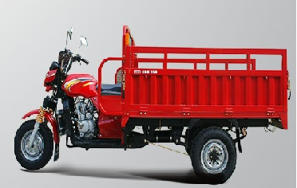
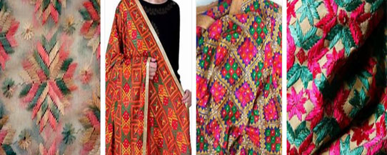
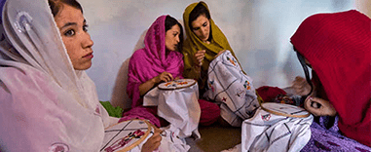
BRIEF FEATURES OF NEW SCHEMES
S# | SCHEME | PURPOSE & BRIEF FEATURES
1 | Financing for “Three Wheeler Loader Rickshaw” | Promote and facilitate farm to market transportation chains Self-employment generation & opportunity creation Provision of a low cost solution & Poverty reduction Pilot launch in five zones: Peshawar, Mirpurkhas, Jhang, Gujranwala, D M Jamali Upto Rs. 0.500 million per borrower/party Recovery within 05 years in half yearly installments
2 | Financing Product for Women Empowerment in Garment and Embroidery Sector | To empower women of the underdeveloped areas Financial Inclusion and poverty reduction Pilot run will be arranged in Multan, Bahawalpur, Gilgit-Baltistan, Quetta and Hyderabad zone branches. Upto Rs. 15,00,000/- per borrower/party Recovery within five years in half yearly installments
3 | Tea Plantation, Processing, Packaging & Marketing | Self-employment generation & opportunity creation. Applicable in Mansehra, Baffa, Shinkiari, Oghi (Abbottabad Zone) & Mingora, Dir (Mingora Zone) branches as Pilot Project. Upto Rs.15,00,000/- per borrower/party. Recovery within 10 years in annual installments
Notes:
ADBP pioneered various initiatives
Introduction of combine harvesters,
UHT treated milk processing units,
Development of poultry,
Potato chips industry in the country.
Conversion of the ADBP into a Public Sector Company was approved by the Federal Government in consultation with State Bank of Pakistan through a summary in August 2002 by the Cabinet Division, GoP, and incorporated as a Public Sector company on October 23, 2002 under the companies Ordinance, 1984.
The purpose of ADBP was to provide credit to the agriculturists for the development & modernization of agriculture and for small cottage industries in rural areas.
ADBP pioneered various initiatives contributed to the agriculture sector of the country i.e. introduction of combine harvesters, UHT treated milk processing units, development of poultry and potato chips industry in the country.

Slide 9
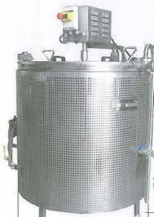
BRIEF FEATURES OF NEW SCHEMES
S# | SCHEME | PURPOSE & BRIEF FEATURES
4 | Financing Product for Raw Sugar (Jiggery/Shakkar) Making, Processing and Packaging | One pilot project in the jurisdiction of Mardan Branch (Peshawar Zone) to be reciprocated in other areas Upto Rs. 15,00,000/- per borrower/party Loan recovered within 05 years in half yearly installments with grace period of 6 months.
5 | Program for Establishment of Small Scale Cheese Making Units in Pakistan | Provide technical assistance and specialized knowledge accompanied by practical knowhow of technology and techniques for using milk for Cheese production. The training will be imparted to the trainees at ZTBL Farm with “train the trainers” concept. The trainer will provide guidelines and transfer the skills to targeted trainees for cheese production.
Notes:
ADBP pioneered various initiatives
Introduction of combine harvesters,
UHT treated milk processing units,
Development of poultry,
Potato chips industry in the country.
Conversion of the ADBP into a Public Sector Company was approved by the Federal Government in consultation with State Bank of Pakistan through a summary in August 2002 by the Cabinet Division, GoP, and incorporated as a Public Sector company on October 23, 2002 under the companies Ordinance, 1984.
The purpose of ADBP was to provide credit to the agriculturists for the development & modernization of agriculture and for small cottage industries in rural areas.
ADBP pioneered various initiatives contributed to the agriculture sector of the country i.e. introduction of combine harvesters, UHT treated milk processing units, development of poultry and potato chips industry in the country.

Slide 10
BRIEF FEATURES OF NEW SCHEMES (In progress)
S# | SCHEME | PURPOSE & BRIEF FEATURES
6 | Financing Product on Horticulture “Production of Flowers” | To support its farmers in Production of flowers and marketing of the same. Higher net profit margin compared with other conventional crops. All branches of ZTBL, Punjab, KPK & Balochistan Upto 1.2 Million per borrower/party Loan recovered within 03 years in half yearly installments
7 | Financing Product for Biofloc Fish Farming | Pilot at ZTBL Farm Upto 1.5 Million per borrower/party. Loan recovered within 03 years in half yearly installments
Notes:
ADBP pioneered various initiatives
Introduction of combine harvesters,
UHT treated milk processing units,
Development of poultry,
Potato chips industry in the country.
Conversion of the ADBP into a Public Sector Company was approved by the Federal Government in consultation with State Bank of Pakistan through a summary in August 2002 by the Cabinet Division, GoP, and incorporated as a Public Sector company on October 23, 2002 under the companies Ordinance, 1984.
The purpose of ADBP was to provide credit to the agriculturists for the development & modernization of agriculture and for small cottage industries in rural areas.
ADBP pioneered various initiatives contributed to the agriculture sector of the country i.e. introduction of combine harvesters, UHT treated milk processing units, development of poultry and potato chips industry in the country.

Slide 11
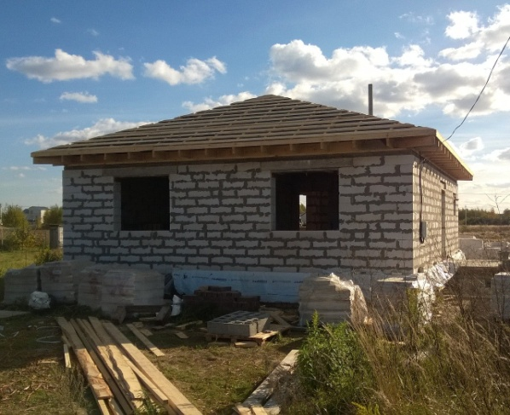
BRIEF FEATURES OF NEW SCHEMES (In progress)
S# | SCHEME | PURPOSE & BRIEF FEATURES
8 | Financing for Black Australorp Chicken Farming (Egg & Meat Production) | Pilot at ZTBL Farm Upto 1.5 Million per borrower/party. Loan recovered within 03 years in half yearly installments
9 | Proposed Financing Product Titled “Mera Gaon Mera Ghar” | • Financing for purchase of Constructed House, Land and subsequent construction and for construction of house on customer owned land and Extension/Expansion in customer owned house. Lahore, Multan, Quetta, Larkana, Gilgit and Muzaffarabad Zones. Rs. 1,000,000 - Rs. 3,000,000 (Upto 3 Million) House upto 125 sq yds (5 Marla) Agri land, Plot documents, postdated cheque of salaried person, postdated cheque of pensioner, Copy of pension book.
Notes:
ADBP pioneered various initiatives
Introduction of combine harvesters,
UHT treated milk processing units,
Development of poultry,
Potato chips industry in the country.
Conversion of the ADBP into a Public Sector Company was approved by the Federal Government in consultation with State Bank of Pakistan through a summary in August 2002 by the Cabinet Division, GoP, and incorporated as a Public Sector company on October 23, 2002 under the companies Ordinance, 1984.
The purpose of ADBP was to provide credit to the agriculturists for the development & modernization of agriculture and for small cottage industries in rural areas.
ADBP pioneered various initiatives contributed to the agriculture sector of the country i.e. introduction of combine harvesters, UHT treated milk processing units, development of poultry and potato chips industry in the country.

Slide 12
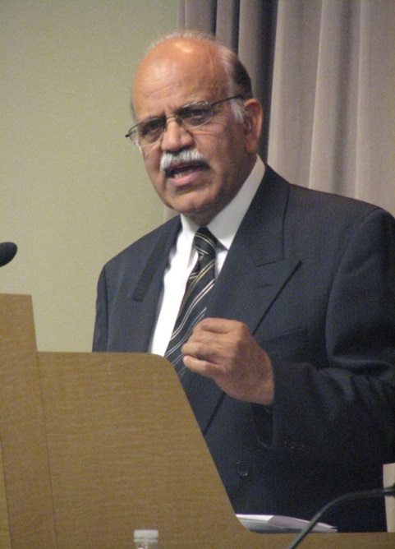
The information has been compiled by Mr. Zaigham M. Rizvi from self study and from different sources. He is grateful to all those serving this noble cause in some form or the other.
Speaker / presenter
Zaigham M. Rizvi
zaigham2r@yahoo.com
Secretary General: Asia-Pacific Union for Housing Finance-APUHF (www.apuhf.info)
Housing Consultant World Bank, UNHABITAT, CMHC-Canada
Ex-Advisor Housing, Central Bank of Pakistan (SBP)
Ex-Advisor Housing Encludes - USA (ShoreBank Int’l )
GCC Advisor on Housing Policy and Finance AHI-USA
Founding Chairman: Advisory Center for Affordable Settlements and Housing
Ambassador Asia: Global Housing Foundation
Chairman: Academia Platform For Housing Research
Senior Adviser Housing: World Bank/IFC

